Slide 1
Planning
Chapter 11.1-11.3
Some material adopted from notes by Andreas Geyer-Schulz
and Chuck Dyer

Slide 2
Overview
What is planning?
Approaches to planning
  GPS / STRIPS
  Situation calculus formalism [revisited]
  Partial-order planning

Slide 3
Planning problem
Find a sequence of actions that achieves a given goal when executed from a given initial world state
That is, given
  a set of operator descriptions defining the possible primitive actions by the agent,
  an initial state description, and
  a goal state description or predicate,
compute a plan, which is
  a sequence of operator instances which after executing them in the initial state changes the world to a goal state
Goals are usually specified as a conjunction of goals to be achieved

Slide 4
Planning vs. problem solving
Planning and problem solving methods can often solve the same sorts of problems
Planning is more powerful and efficient because of the representations and methods used
States, goals, and actions are decomposed into sets of sentences (usually in first-order logic)
Search often proceeds through plan space rather than state space (though there are also state-space planners)
Subgoals can be planned independently, reducing the complexity of the planning problem

Slide 5
Typical assumptions
Atomic time: Each action is indivisible
No concurrent actions allowed, but actions need not be ordered w.r.t each other in the plan
Deterministic actions: action results completely determined — no uncertainty in their effects
Agent is the sole cause of change in the world
Agent is omniscient with complete knowledge of the state of the world
Closed world assumption where everything known to be true in the world is included in the state description and anything not listed is false

Slide 6
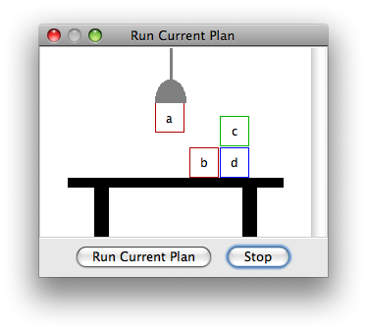
Blocks world
The blocks world is a micro-world consisting of a table, a set of blocks and a robot hand.
Some domain constraints:
  Only one block can be on another block
  Any number of blocks can be on
  the table
  The hand can only hold one block
Typical representation:
  ontable(b) ontable(d)
  on(c,d) holding(a)
  clear(b) clear(c)
Meant to be a simple model!

Slide 7
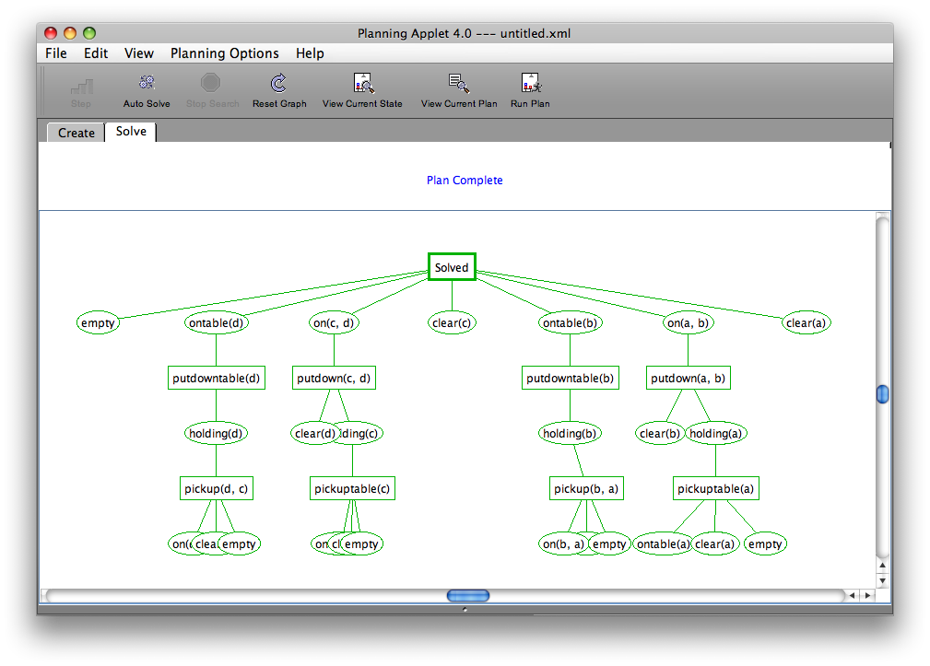
Try demo at http://aispace.org/planning/

Slide 8
Major approaches
Planning as search
GPS / STRIPS
Situation calculus
Partial order planning
Hierarchical decomposition (HTN planning)
Planning with constraints (SATplan, Graphplan)
Reactive planning

Slide 9
Planning as Search
We could think of planning as just another search problem
Actions: generate successor states
States: completely described & only used for successor generation, heuristic fn. evaluation & goal testing.
Goals: represented as a goal test and using a heuristic function
Plan representation: an unbroken sequences of actions forward from initial states (or backward from goal state)

Slide 10
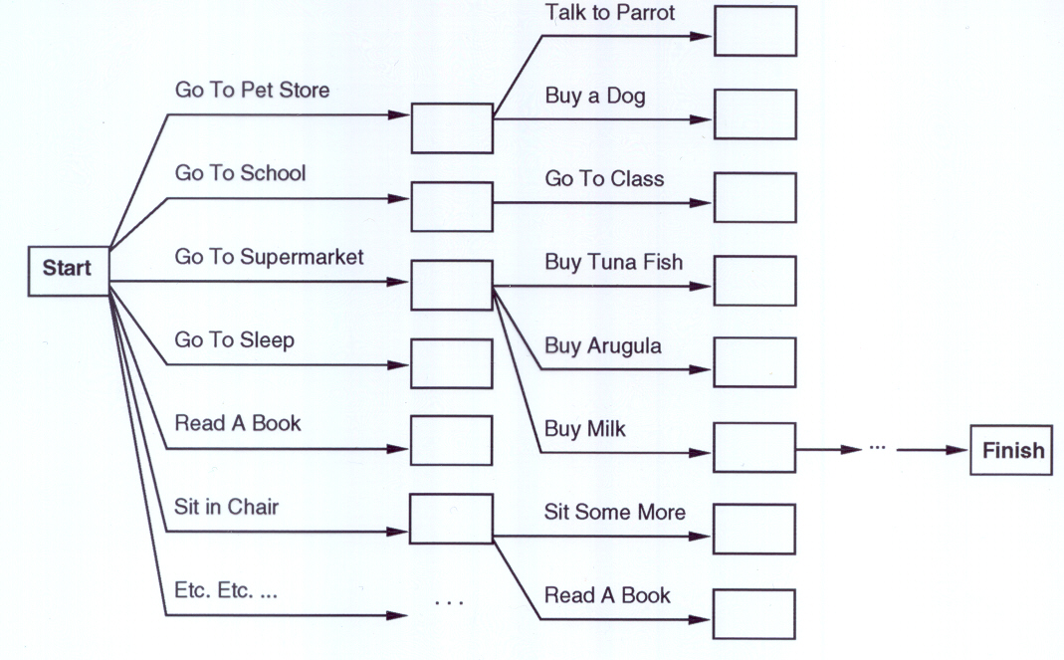
“Get a quart of milk, a bunch of bananas and a variable-speed cordless drill.”
Treating planning as a search problem isn’t very efficient

Slide 11
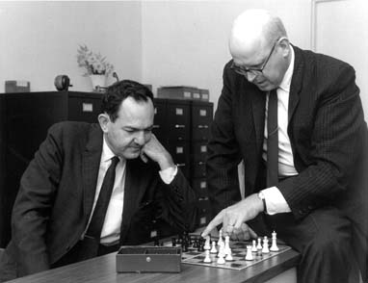
General Problem Solver
The General Problem Solver (GPS)
system was an early planner
(Newell, Shaw, and Simon, 1957)
GPS generated actions that reduced the difference between some state and a goal state
GPS used Means-Ends Analysis
  Compare given to desired states; select a best action to do next
  A table of differences identifies procedures to reduce types of differences
GPS was a state space planner: it operated in the domain of state space problems specified by an initial state, some goal states, and a set of operations
Introduced a general way to use domain knowledge to select most promising action to take next

Slide 12
Situation calculus planning
Intuition: Represent the planning problem using first-order logic
  Situation calculus lets us reason about changes in the world
  Use theorem proving to “prove” that a particular sequence of actions, when applied to the initial situation leads to desired result
This is how the “neats” approach the problem

Slide 13
Situation calculus
Initial state: logical sentence about (situation) S₀
  At(Home, S₀) ∧ ¬Have(Milk, S₀) ∧ ¬ Have(Bananas, S₀) ∧ ¬ Have(Drill, S₀)
Goal state:
  (∃s) At(Home,s) ∧ Have(Milk,s) ∧ Have(Bananas,s) ∧ Have(Drill,s)
Operators are descriptions of how world changes as a result of actions:
  ∀(a,s) Have(Milk,Result(a,s)) ⇔
  ((a=Buy(Milk) ∧ At(Grocery,s)) ∨ (Have(Milk, s) ∧ a ≠ Drop(Milk)))
Result(a,s) names situation resulting from executing action a in situation s
Action sequences also useful: Result'(l,s) is result of executing the list of actions (l) starting in s:
  (∀s) Result'([],s) = s
  (∀a,p,s) Result'([a|p]s) = Result'(p,Result(a,s))

Slide 14
Situation calculus II
A solution is a plan that when applied to the initial state yields situation satisfying the goal:
  At(Home, Result'(p,S₀))
  ∧ Have(Milk, Result'(p,S₀))
  ∧ Have(Bananas, Result'(p,S₀))
  ∧ Have(Drill, Result'(p,S₀))
We expect a plan (i.e., variable assignment through unification) such as:
  p = [Go(Grocery), Buy(Milk), Buy(Bananas),
  Go(HardwareStore), Buy(Drill), Go(Home)]

Slide 15
Situation calculus: Blocks world
An example of a situation calculus rule for the blocks world:
  Clear (X, Result(A,S)) ↔
  [Clear (X, S) ∧
  (¬(A=Stack(Y,X) ∨ A=Pickup(X))
  ∨ (A=Stack(Y,X) ∧ ¬(holding(Y,S))
  ∨ (A=Pickup(X) ∧ ¬(handempty(S) ∧ ontable(X,S) ∧ clear(X,S))))]
  ∨ [A=Stack(X,Y) ∧ holding(X,S) ∧ clear(Y,S)]
  ∨ [A=Unstack(Y,X) ∧ on(Y,X,S) ∧ clear(Y,S) ∧ handempty(S)]
  ∨ [A=Putdown(X) ∧ holding(X,S)]
English translation: A block is clear if (a) in the previous state it was clear and we didn’t pick it up or stack something on it successfully, or (b) we stacked it on something else successfully, or (c) something was on it that we unstacked successfully, or (d) we were holding it and we put it down.
Whew!!! There’s gotta be a better way!

Slide 16
Situation calculus planning: Analysis
Fine in theory, but remember that problem solving (search) is exponential in the worst case
Resolution theorem proving only finds a proof (plan), not necessarily a good plan
So, restrict the language and use a special-purpose algorithm (a planner) rather than general theorem prover
Since planning is a ubiquitous task for an intelligent agent, it’s reasonable to develop a special purpose subsystem for it.

Slide 17
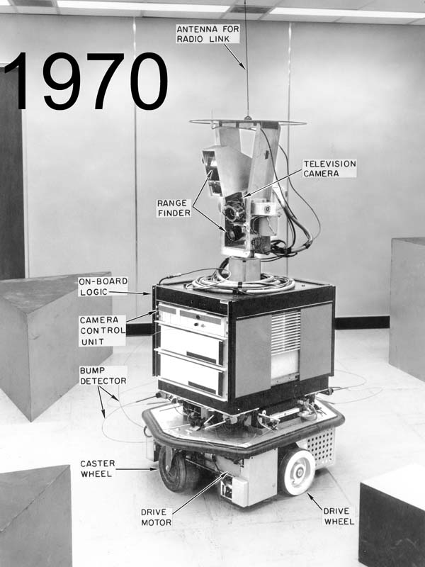
Strips planning representation
Classic approach first used in the STRIPS
(Stanford Research Institute Problem Solver) planner
A State is a conjunction of ground literals
  at(Home) ∧ ¬have(Milk) ∧ ¬have(bananas) ...
Goals are conjunctions of literals, but may have
variables, assumed to be existentially quantified
  at(?x) ∧ have(Milk) ∧ have(bananas) ...
Don’t need to fully specify state
  Non-specified conditions either don’t-care or assumed false
  Represent many cases in small storage
  Often only represent changes in state rather than entire situation
Unlike theorem prover, not seeking whether goal is true, but is there a sequence of actions to attain it
Shakey the robot

Slide 18

Shakey video circa 1969
94M!
http://www.cs.umbc.edu/ai/videos/shakey.avi

Slide 19
Operator/action representation
Operators contain three components:
  Action description
  Precondition - conjunction of positive literals
  Effect - conjunction of positive or negative literals describing how situation changes when operator is applied
Example:
  Op[Action: Go(there),
  Precond: At(here) ∧ Path(here,there),
  Effect: At(there) ∧ ¬At(here)]
All variables are universally quantified
Situation variables are implicit
  preconditions must be true in the state immediately before operator is applied; effects are true immediately after
At(here) ,Path(here,there)
Go(there)
At(there) , ¬At(here)

Slide 20
Blocks world operators
Here are the classic basic operations for the blocks world:
  stack(X,Y): put block X on block Y
  unstack(X,Y): remove block X from block Y
  pickup(X): pickup block X
  putdown(X): put block X on the table
Each will be represented by
  a list of preconditions
  a list of new facts to be added (add-effects)
  a list of facts to be removed (delete-effects)
  optionally, a set of (simple) variable constraints
For example:
  preconditions(stack(X,Y), [holding(X), clear(Y)])
  deletes(stack(X,Y), [holding(X), clear(Y)]).
  adds(stack(X,Y), [handempty, on(X,Y), clear(X)])
  constraints(stack(X,Y), [X≠Y, Y≠table, X≠table])

Slide 21
Blocks world operators (Prolog)
operator(stack(X,Y),
Precond [holding(X), clear(Y)],
Add [handempty, on(X,Y), clear(X)],
Delete [holding(X), clear(Y)],
Constr [X≠Y, Y≠table, X≠table]).
operator(pickup(X),
[ontable(X), clear(X), handempty],
[holding(X)],
[ontable(X), clear(X), handempty],
[X≠table]).
operator(unstack(X,Y),
[on(X,Y), clear(X), handempty],
[holding(X), clear(Y)],
[handempty, clear(X), on(X,Y)],
[X≠Y, Y≠table, X≠table]).
operator(putdown(X),
[holding(X)],
[ontable(X), handempty, clear(X)],
[holding(X)],
[X≠table]).

Slide 22
STRIPS planning
STRIPS maintains two additional data structures:
  State List - all currently true predicates.
  Goal Stack - a push down stack of goals to be solved, with current goal on top of stack.
If current goal is not satisfied by present state, examine add lists of operators, and push operator and preconditions list on stack. (Subgoals)
When a current goal is satisfied, POP it from stack.
When an operator is on top stack, record the application of that operator on the plan sequence and use the operator’s add and delete lists to update the current state.

Slide 23
Typical BW planning problem
Initial state:
  clear(a)
  clear(b)
  clear(c)
  ontable(a)
  ontable(b)
  ontable(c)
  handempty
Goal:
  on(b,c)
  on(a,b)
  ontable(c)
A plan:
  pickup(b)
  stack(b,c)
  pickup(a)
  stack(a,b)
A
C
B
A
B
C

Slide 24
Trace (Prolog)
strips([on(b,c),on(a,b),ontable(c)],[clear(a),clear(b),clear(c),ontable(a),ontable(b),ontable(c),handempty],[])
Achieve on(b,c) via stack(b,c) with preconds: [holding(b),clear(c)]
  strips([holding(b),clear(c)],[clear(a),clear(b),clear(c),ontable(a),ontable(b),ontable(c),handempty],[])
  Achieve holding(b) via pickup(b) with preconds: [ontable(b),clear(b),handempty]
    strips([ontable(b),clear(b),handempty],[clear(a),clear(b),clear(c),ontable(a),ontable(b),ontable(c),handempty],[])
  Applying pickup(b)
  strips([holding(b),clear(c)],[clear(a),clear(c),holding(b),ontable(a),ontable(c)],[pickup(b)])
Applying stack(b,c)
strips([on(b,c),on(a,b),ontable(c)],[handempty,clear(a),clear(b),ontable(a),ontable(c),on(b,c)],[stack(b,c),pickup(b)])
Achieve on(a,b) via stack(a,b) with preconds: [holding(a),clear(b)]
  strips([holding(a),clear(b)],[handempty,clear(a),clear(b),ontable(a),ontable(c),on(b,c)],[stack(b,c),pickup(b)])
  Achieve holding(a) via pickup(a) with preconds: [ontable(a),clear(a),handempty]
    strips([ontable(a),clear(a),handempty],[handempty,clear(a),clear(b),ontable(a),ontable(c),on(b,c)],[stack(b,c),pickup(b)])
  Applying pickup(a)
  strips([holding(a),clear(b)],[clear(b),holding(a),ontable(c),on(b,c)],[pickup(a),stack(b,c),pickup(b)])
Applying stack(a,b)
strips([on(b,c),on(a,b),ontable(c)],[handempty,clear(a),ontable(c),on(a,b),on(b,c)],[stack(a,b),pickup(a),stack(b,c),pickup(b)])

Slide 25
Strips in Prolog
strips(Goals, State, Plan, NewState, NewPlan):-
% Goal is an unsatisfied goal.
member(Goal, Goals),
(\+ member(Goal, State)),
% Op is an Operator with Goal as a result.
operator(Op, Preconditions, Adds, Deletes,_),
member(Goal,Adds),
% Achieve the preconditions
strips(Preconditions, State, Plan, TmpState1, TmpPlan1),
% Apply the Operator
diff(TmpState1, Deletes, TmpState2),
union(Adds, TmpState2, TmpState3).
% Continue planning.
strips(GoalList, TmpState3, [Op|TmpPlan1], NewState, NewPlan).
% strips(+Goals, +InitState, -Plan)
strips(Goal, InitState, Plan):-
strips(Goal, InitState, [], _, RevPlan),
reverse(RevPlan, Plan).
% strips(+Goals,+State,+Plan,-NewState, NewPlan )
% Finished if each goal in Goals is true
% in current State.
strips(Goals, State, Plan, State, Plan) :-
subset(Goals,State).

Slide 26
Another BW planning problem
Initial state:
  clear(a)
  clear(b)
  clear(c)
  ontable(a)
  ontable(b)
  ontable(c)
  handempty
Goal:
  on(a,b)
  on(b,c)
  ontable(c)
A plan:
  pickup(a)
stack(a,b)
unstack(a,b)
putdown(a)
pickup(b)
stack(b,c)
pickup(a)
stack(a,b)
A
C
B
A
B
C

Slide 27
Yet Another BW planning problem
Plan:
  unstack(c,b)
  putdown(c)
  unstack(b,a)
  putdown(b)
  pickup(b)
  stack(b,a)
  unstack(b,a)
  putdown(b)
  pickup(a)
  stack(a,b)
  unstack(a,b)
  putdown(a)
  pickup(b)
  stack(b,c)
  pickup(a)
  stack(a,b)
Initial state:
  clear(c)
  ontable(a)
  on(b,a)
  on(c,b)
  handempty
Goal:
  on(a,b)
  on(b,c)
  ontable(c)
C
B
A
A
B
C

Slide 28
Yet Another BW planning problem
Initial state:
  ontable(a)
  ontable(b)
  clear(a)
  clear(b)
  handempty
Goal:
  on(a,b)
  on(b,a)
Plan:
  ??
A
B

Slide 29
Goal interaction
Simple planning algorithms assume independent sub-goals
  Solve each separately and concatenate the solutions
The “Sussman Anomaly” is the classic example of the goal interaction problem:
  Solving on(A,B) first (via unstack(C,A), stack(A,B)) is undone when solving 2nd goal on(B,C) (via unstack(A,B), stack(B,C))
  Solving on(B,C) first will be undone when solving on(A,B)
Classic STRIPS couldn’tt handle this, although minor modifications can get it to do simple cases
A
C
B
A
B
C
Initial state
Goal state

Slide 30
Sussman Anomaly
Achieve on(a,b) via stack(a,b) with preconds: [holding(a),clear(b)]
|Achieve holding(a) via pickup(a) with preconds: [ontable(a),clear(a),handempty]
||Achieve clear(a) via unstack(_1584,a) with preconds: [on(_1584,a),clear(_1584),handempty]
||Applying unstack(c,a)
||Achieve handempty via putdown(_2691) with preconds: [holding(_2691)]
||Applying putdown(c)
|Applying pickup(a)
Applying stack(a,b)
Achieve on(b,c) via stack(b,c) with preconds: [holding(b),clear(c)]
|Achieve holding(b) via pickup(b) with preconds: [ontable(b),clear(b),handempty]
||Achieve clear(b) via unstack(_5625,b) with preconds: [on(_5625,b),clear(_5625),handempty]
||Applying unstack(a,b)
||Achieve handempty via putdown(_6648) with preconds: [holding(_6648)]
||Applying putdown(a)
|Applying pickup(b)
Applying stack(b,c)
Achieve on(a,b) via stack(a,b) with preconds: [holding(a),clear(b)]
|Achieve holding(a) via pickup(a) with preconds: [ontable(a),clear(a),handempty]
|Applying pickup(a)
Applying stack(a,b)
From [clear(b),clear(c),ontable(a),ontable(b),on(c,a),handempty]
To [on(a,b),on(b,c),ontable(c)]
Do:
unstack(c,a)
putdown(c)
pickup(a)
stack(a,b)
unstack(a,b)
putdown(a)
pickup(b)
stack(b,c)
pickup(a)
stack(a,b)
Goal state
A
Initial state
C
B
A
B
C

Slide 31
Sussman Anomaly
Classic Strips assumed that once a goal had been satisfied it would stay satisfied.
Our simple Prolog version selects any currently unsatisfied goal to tackle at each iteration.
This can handle this problem, at the expense of looping for other problems.
What’s needed? -- a notion of “protecting” a sub-goal so that it isn’t undone by some later step.

Slide 32
State-space planning
STRIPS searches thru a space of situations (where you are, what you have, etc.)
  Plan is a solution found by “searching” through the situations to get to the goal
Progression planners search forward from initial state to goal state
  Usually results in a high branching factor
Regression planners search backward from goal
  OK if operators have enough information to go both ways
  Ideally this leads to reduced branching –you are only considering things that are relevant to the goal
  Handling a conjunction of goals is difficult (e.g., STRIPS)

Slide 33
Some example domains
We’ll use some simple problems with a real world flavor to illustrate planning problems and algorithms
Putting on your socks and hoes in the morning
  Actions like put-on-left-sock, put-on-right-shoe
Planning a shopping trip involving buying several kinds of items
  Actions like go(X), buy(Y)

Slide 34
Plan-space planning
An alternative is to search through the space of plans, rather than situations
Start from a partial plan which is expanded and refined until a complete plan is generated
Refinement operators add constraints to the partial plan and modification operators for other changes
We can still use STRIPS-style operators:
  Op(ACTION: RightShoe, PRECOND: RightSockOn, EFFECT: RightShoeOn)
  Op(ACTION: RightSock, EFFECT: RightSockOn)
  Op(ACTION: LeftShoe, PRECOND: LeftSockOn, EFFECT: LeftShoeOn)
  Op(ACTION: LeftSock, EFFECT: leftSockOn)
could result in a partial plan of
  [ … RightShoe … LeftShoe …]

Slide 35
Partial-order planning
A linear planner builds a plan as a totally ordered sequence of plan steps
A non-linear planner (aka partial-order planner) builds up a plan as a set of steps with some temporal constraints
  constraints like S1<S2 if step S1 must come before S2.
One refines a partially ordered plan (POP) by either:
  adding a new plan step, or
  adding a new constraint to the steps already in the plan.
A POP can be linearized (converted to a totally ordered plan) by topological sorting

Slide 36
A simple graphical notation
Start
Start
Initial State
Goal State
LeftShoeOn RightShoeOn
Finish
Finish
(a)
(b)

Slide 37
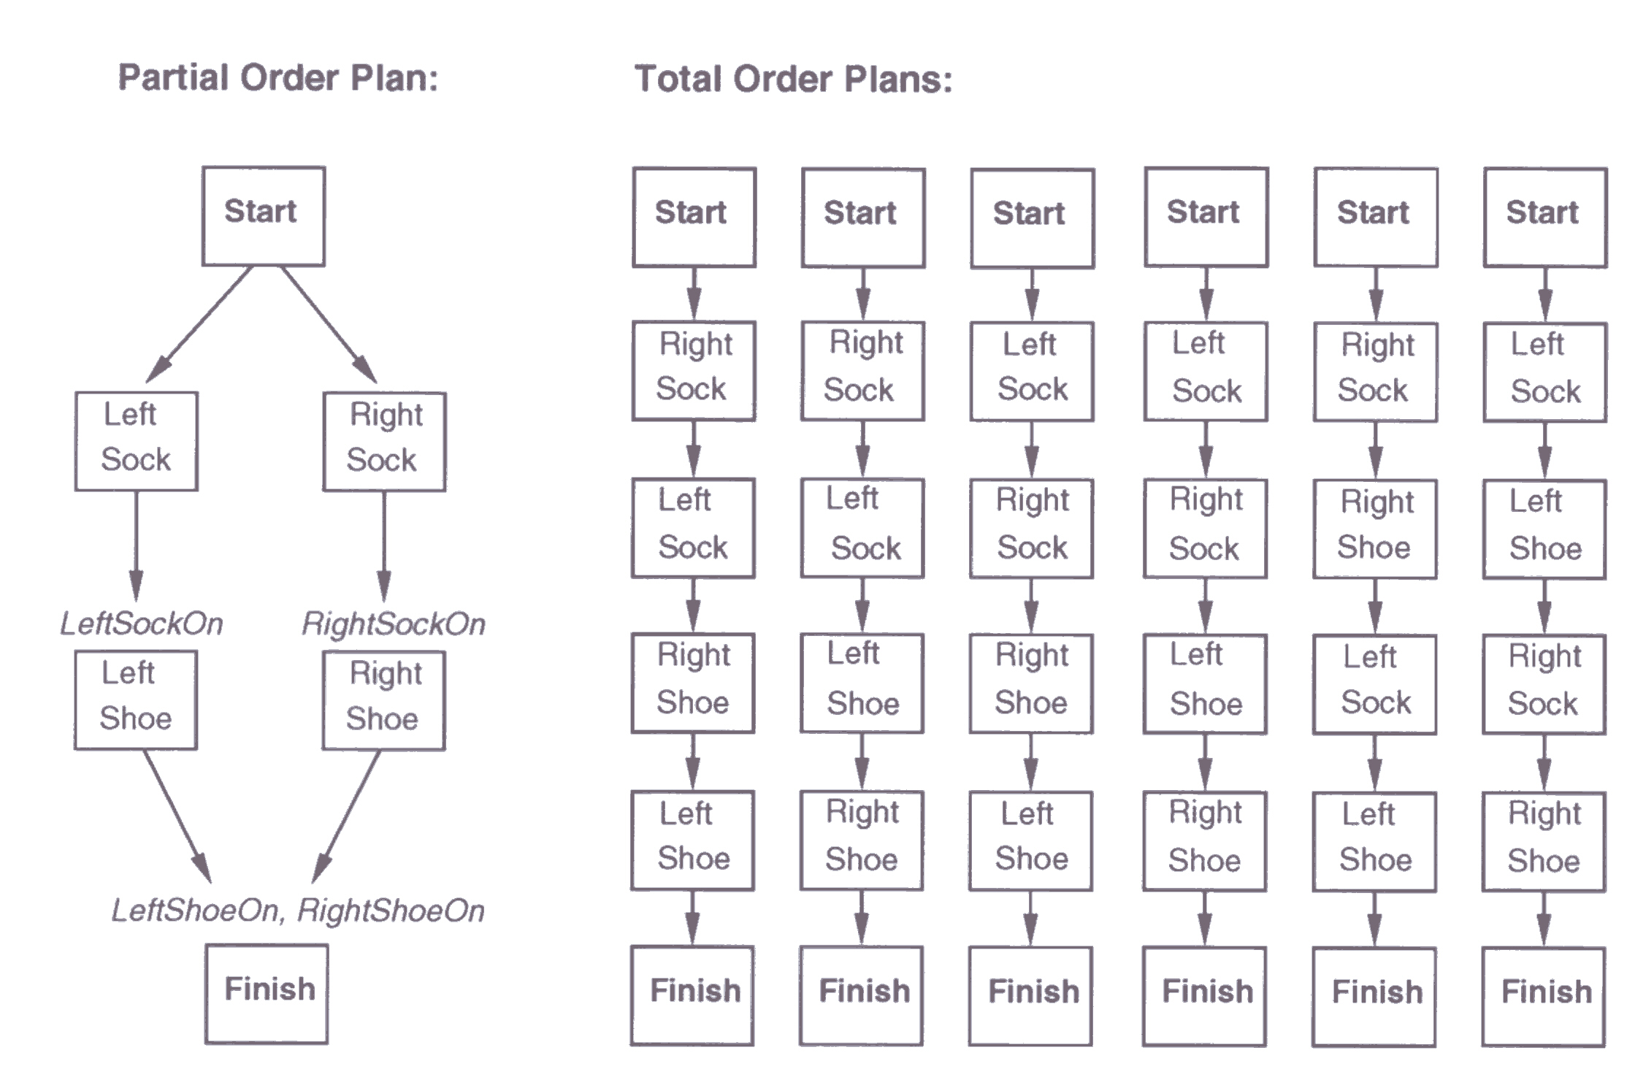
Partial Order Plan vs. Total Order Plan
The space of POPs is smaller than TOPs and hence involve less search

Slide 38
Least commitment
Non-linear planners embody the principle of least commitment
  only choose actions, orderings, and variable bindings absolutely necessary, leaving other decisions till later
  avoids early commitment to decisions that don’t really matter
A linear planner always chooses to add a plan step in a particular place in the sequence
A non-linear planner chooses to add a step and possibly some temporal constraints

Slide 39
Non-linear plan
A non-linear plan consists of
  (1) A set of steps {S₁, S₂, S₃, S₄…}
    Steps have operator descriptions, preconditions & post-conditions
  (2) A set of causal links { … (S_{i},C,S_{j}) …}
    Purpose of step S_{i} is to achieve precondition C of step S_{j}
  (3) A set of ordering constraints { … S_{i}<S_{j} … }
    Step S_{i} must come before step S_{j}
A non-linear plan is complete iff
  Every step mentioned in (2) and (3) is in (1)
  If S_{j} has prerequisite C, then there exists a causal link in (2) of the form (S_{i},C,S_{j}) for some S_{i}
  If (S_{i},C,S_{j}) is in (2) and step S_{k} is in (1), and S_{k} threatens (S_{i},C,S_{j}) (makes C false), then (3) contains either S_{k}<S_{i} or S_{j}<S_{k}

Slide 40
The initial plan
Every plan starts the same way
S1:Start
Initial State
Goal State
S2:Finish

Slide 41
Trivial example
Operators:
  Op(ACTION: RightShoe, PRECOND: RightSockOn, EFFECT: RightShoeOn)
  Op(ACTION: RightSock, EFFECT: RightSockOn)
  Op(ACTION: LeftShoe, PRECOND: LeftSockOn, EFFECT: LeftShoeOn)
  Op(ACTION: LeftSock, EFFECT: leftSockOn)
S1:Start
Steps: {S1:[Op(Action:Start)],
S2:[Op(Action:Finish,
Pre: RightShoeOn^LeftShoeOn)]}
Links: {}
Orderings: {S1<S2}
RightShoeOn ^ LeftShoeOn
S2:Finish

Slide 42
Solution
Start
Left
Sock
Right
Sock
Left
Shoe
Right
Shoe
Finish

Slide 43
POP constraints and search heuristics
Only add steps that achieve a currently unachieved precondition
Use a least-commitment approach:
  Don’t order steps unless they need to be ordered
Honor causal links S₁ → S₂ that protect condition c:
  Never add an intervening step S₃ that violates c
  If a parallel action threatens c (i.e., has effect of negating or clobbering c), resolve threat by adding ordering links:
    Order S₃ before S₁ (demotion)
    Order S₃ after S₂ (promotion)
c

Slide 44
Partial-order planning example
Initially: at home; SM sells bananas, milk; HWS sells drills
Goal: Have milk, bananas, and a drill
Start
At(Home) Sells(SM, Banana) Sells(SM,Milk) Sells(HWS,Drill)
Have(Drill) Have(Milk) Have(Banana) At(Home)
Finish

Slide 45
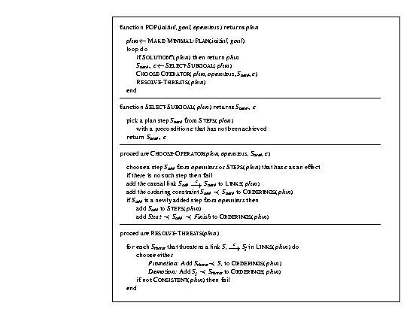

Slide 46
Planning
Ordering constraints
Start
At(s), Sells(s,Drill)
At(s), Sells(s,Milk)
At(s), Sells(s,Bananas)
Buy(Drill)
Buy(Milk)
Buy(Bananas)
Have(Drill)
Have(Milk)
Have(Bananas)
Have(Drill), Have(Milk), Have(Bananas), At(Home)
Finish
Causal links (protected)
Have light arrows at every bold arrow.
Start
At(HWS), Sells(HWS,Drill)
At(SM), Sells(SM,Milk)
At(SM), Sells(SM,Bananas)
Buy(Drill)
Buy(Milk)
Buy(Bananas)
Have(Drill), Have(Milk), Have(Bananas), At(Home)
Finish

Slide 47
Planning
Start
At(x)
At (x)
Go(HWS)
Go(SM)
At(HWS), Sells(HWS,Drill)
At(SM), Sells(SM,Milk)
At(SM), Sells(SM,Bananas)
Buy(Drill)
Buy(Milk)
Buy(Bananas)
Have(Drill), Have(Milk), Have(Bananas), At(Home)
Finish

Slide 48
Planning
Impasse → must backtrack & make another choice
Start
At(Home)
At (Home)
Go(HWS)
Go(SM)
At(HWS), Sells(HWS,Drill)
At(SM), Sells(SM,Milk)
At(SM), Sells(SM,Bananas)
Buy(Drill)
Buy(Milk)
Buy(Bananas)
Have(Drill), Have(Milk), Have(Bananas), At(Home)
Finish

Slide 49
How to identify a dead end?
S₁
S₃
S₁
S₁
¬c
c
S₃
c
S₂
¬c
S₂
c
S₂
S₃
¬c
(a)
(c)
Promotion
(b)
Demotion
The S₃ action threatens the c precondition of S₂ if S₃ neither precedes nor follows S₂ and S₃ has an effect that negates c.
Resolving a threat

Slide 50
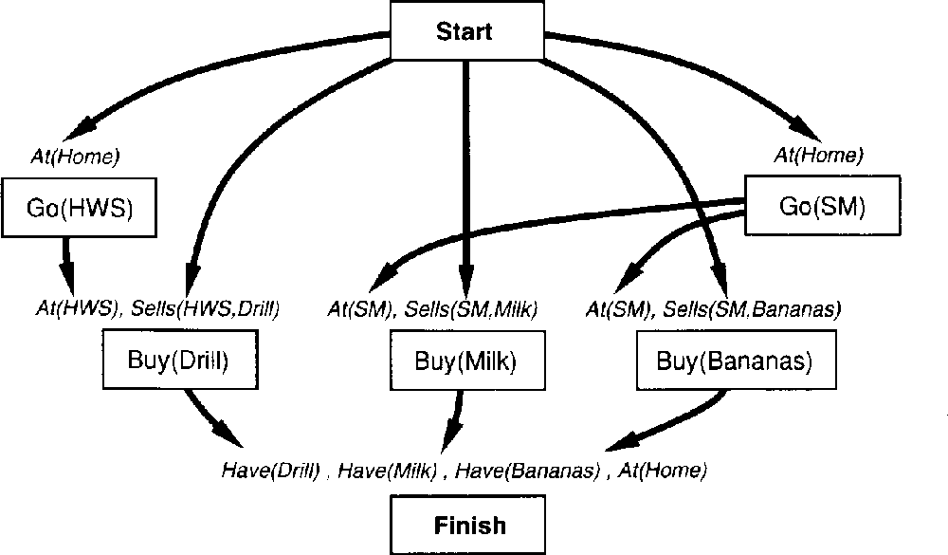
Consider the threats
At(l₂)
At(l₁)
At(x)
Go(l₁,HWS)
Go(l₂, SM)
At(HWS), Sells(HWS,Drill)
At(SM), Sells(SM,Milk)
At(SM), Sells(SM,Bananas)
Buy(Drill,HWS)
Buy(Milk,SM)
Buy(Bananas,SM)
Have(Drill), Have(Milk), Have(Bananas), At(Home)

Slide 51
Resolve a threat
To resolve the third threat, make Buy(Drill) precede Go(SM)
  This resolves all three threats
To resolve the third threat, make Buy(Drill) precede Go(SM)
  This resolves all three threats
At(l₂)
At(l₁)
At(x)
Go(l₁,HWS)
Go(l₂, SM)
At(HWS), Sells(HWS,Drill)
At(SM), Sells(SM,Milk)
At(SM), Sells(SM,Bananas)
Buy(Drill,HWS)
Buy(Milk,SM)
Buy(Bananas,SM)
Have(Drill), Have(Milk), Have(Bananas), At(Home)

Slide 52
Planning
1. Try to go from HWS to SM
(i.e. a different way of achieving At(x))
Start
At(Home)
At (HWS)
Go(HWS)
Go(SM)
2. by promotion
At(HWS), Sells(HWS,Drill)
At(SM), Sells(SM,Milk)
At(SM), Sells(SM,Bananas)
At(SM)
Buy(Drill)
Buy(Milk)
Buy(Bananas)
Go(Home)
Have(Drill), Have(Milk), Have(Bananas), At(Home)
Finish

Slide 53
Final Plan
Establish At(l₃) with l₃=SM
At(HWS)
At(Home)
At(x)
Go(Home,HWS)
Go(HWS,SM)
At(HWS), Sells(HWS,Drill)
At(SM), Sells(SM,Milk)
At(SM), Sells(SM,Bananas)
At(SM)
Buy(Drill,HWS)
Buy(Milk,SM)
Buy(Bananas,SM)
Go(SM,Home)
Have(Drill), Have(Milk), Have(Bananas), At(Home)

Slide 54
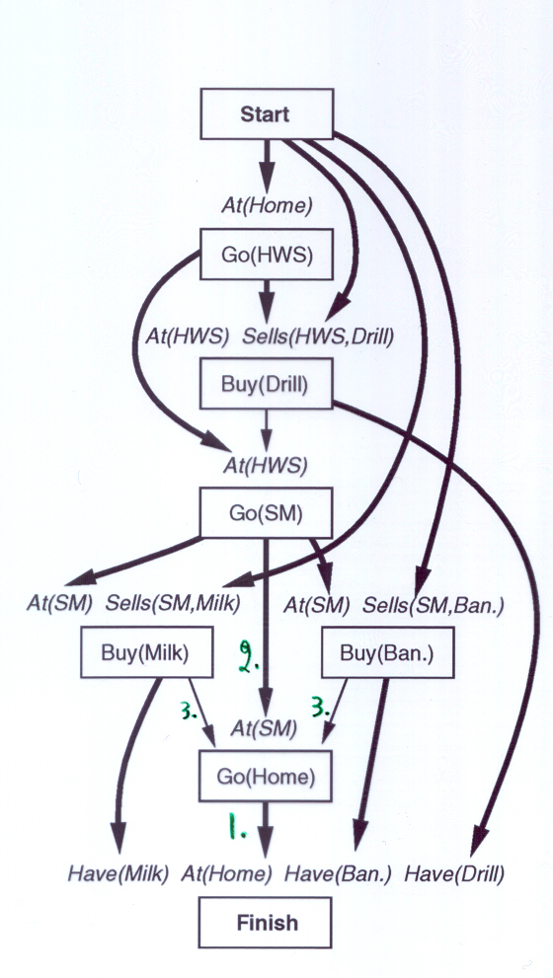
The final plan
If 2 would try At(HWS) or At(Home), threats could not be resolved.

Slide 55
Real-world planning domains
Real-world domains are complex and don’t satisfy the assumptions of STRIPS or partial-order planning methods
Some of the characteristics we may need to handle:
  Modeling and reasoning about resources
  Representing and reasoning about time
  Planning at different levels of abstractions
  Conditional outcomes of actions
  Uncertain outcomes of actions
  Exogenous events
  Incremental plan development
  Dynamic real-time replanning
} Scheduling
} Planning under uncertainty
} HTN planning

Slide 56
Hierarchical decomposition
Hierarchical decomposition, or hierarchical task network (HTN) planning, uses abstract operators to incrementally decompose a planning problem from a high-level goal statement to a primitive plan network
Primitive operators represent actions that are executable, and can appear in the final plan
Non-primitive operators represent goals (equivalently, abstract actions) that require further decomposition (or operationalization) to be executed
There is no “right” set of primitive actions: One agent’s goals are another agent’s actions!

Slide 57
HTN operator: Example
OPERATOR decompose
PURPOSE: Construction
CONSTRAINTS:
Length (Frame) <= Length (Foundation),
Strength (Foundation) > Wt(Frame) + Wt(Roof)
+ Wt(Walls) + Wt(Interior) + Wt(Contents)
PLOT: Build (Foundation)
Build (Frame)
PARALLEL
Build (Roof)
Build (Walls)
END PARALLEL
Build (Interior)

Slide 58
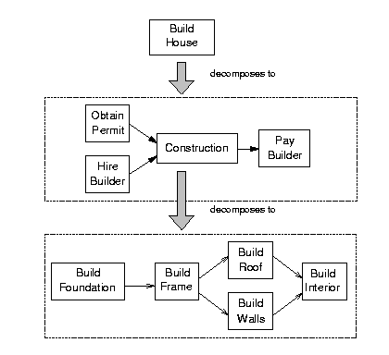
HTN planning: example

Slide 59
HTN operator representation
Russell & Norvig explicitly represent causal links; these can also be computed dynamically by using a model of preconditions and effects
Dynamically computing causal links means that actions from one operator can safely be interleaved with other operators, and subactions can safely be removed or replaced during plan repair
Russell & Norvig’s representation only includes variable bindings, but more generally we can introduce a wide array of variable constraints

Slide 60
Truth criterion
Determining if a formula is true at a particular point in a partially ordered plan is, in general, NP-hard
Intuition: there are exponentially many ways to linearize a partially ordered plan
Worst case: if there are N actions unordered with respect to each other, there are N! linearizations
Ensuring soundness of truth criterion requires checking formula under all possible linearizations
Use heuristic methods instead to make planning feasible
Check later to ensure no constraints are violated

Slide 61
Truth criterion in HTN planners
Heuristic: prove that there is one possible ordering of the actions that makes the formula true – but don’t insert ordering links to enforce that order
Such a proof is efficient
  Suppose you have an action A1 with a precondition P
  Find an action A2 that achieves P (A2 could be initial world state)
  Make sure there is no action necessarily between A2 and A1 that negates P
Applying this heuristic for all preconditions in the plan can result in infeasible plans

Slide 62
Increasing expressivity
Conditional effects
  Instead of having different operators for different conditions, use a single operator with conditional effects
  Move (block1, from, to) and MoveToTable (block1, from) collapse into one Move (block1, from, to):
    Op(ACTION: Move(block1, from, to),
    PRECOND: On (block1, from) ^ Clear (block1) ^ Clear (to)
    EFFECT: On (block1, to) ^ Clear (from) ^ ~On(block1, from) ^ ~Clear(to) when to<>Table
    There’s a problem with this operator: can you spot what it is?
Negated and disjunctive goals
Universally quantified preconditions and effects

Slide 63
Reasoning about resources
Introduce numeric variables used as measures
These variables represent resource quantities, and change over the course of the plan
Certain actions may produce (increase the quantity of) resources
Other actions may consume (decrease the quantity of) resources
More generally, may want different resource types
  Continuous vs. discrete
  Sharable vs. nonsharable
  Reusable vs. consumable vs. self-replenishing

Slide 64
Other real-world planning issues
Conditional planning
Partial observability
Information gathering actions
Execution monitoring and replanning
Continuous planning
Multi-agent (cooperative or adversarial) planning

Slide 65
Planning summary
Planning representations
  Situation calculus
  STRIPS representation: Preconditions and effects
Planning approaches
  State-space search (STRIPS, forward chaining, ….)
  Plan-space search (partial-order planning, HTN, …)
  Constraint-based search (GraphPlan, SATplan, …)
Search strategies
  Forward planning
  Goal regression
  Backward planning
  Least-commitment
  Nonlinear planning

